Slide 1
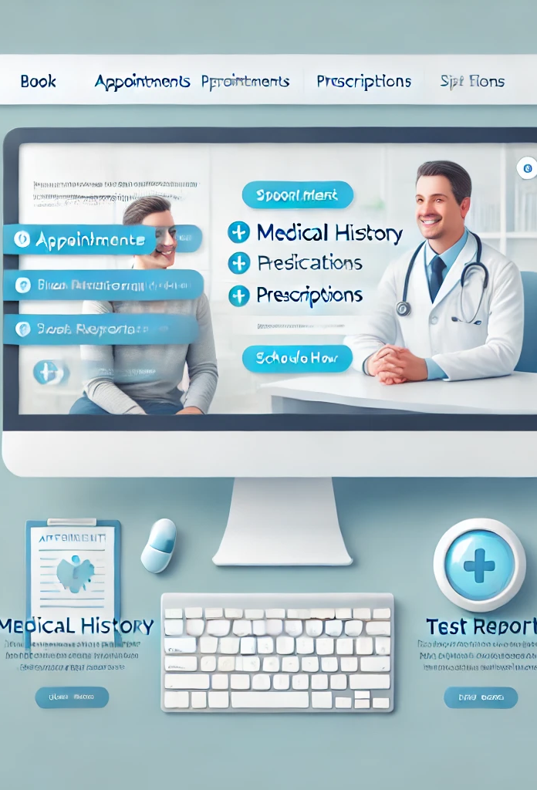
Patient care web portal
Team 24
Choladevi Gheereddy A20544476
Arvind Divakar A20543054
Manogna Vadlamudi A20551908
Tejaswini Bollepalli A20562616

Slide 2

Problem statement
Healthcare providers face challenges in managing Patient Care Web Portal that enables patients to easily book appointments, securely access their medical records and prescriptions, and review test results. By using the Agile Scrum framework, we will manage this development process in iterative cycles, ensuring continuous improvement, flexibility, and responsiveness to user feedback. This approach will streamline communication between healthcare providers and patients, enhance patient engagement, and improve overall satisfaction with timely access to healthcare information and services.

Slide 3
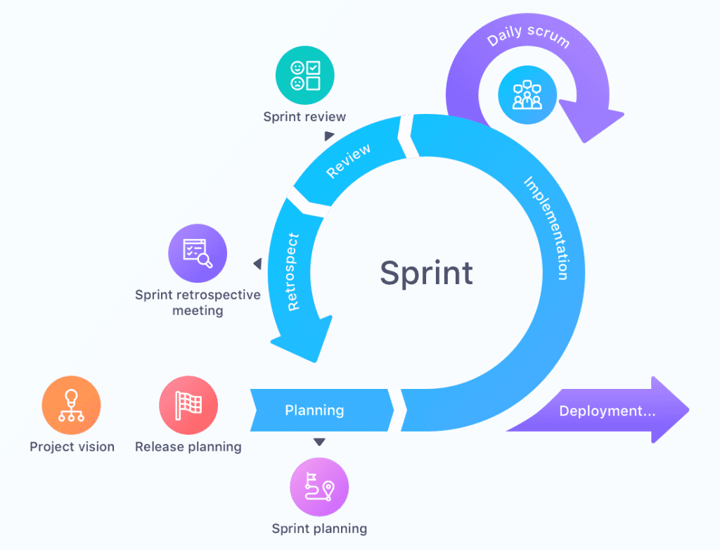
Agile Scrum Framework
The process begins with Project Vision and Release Planning, where the team defines the project goals and timelines.
Sprint Planning sets specific tasks for a sprint, a short, time-boxed period focused on completing a subset of the project.
During the sprint, the team conducts a Daily Scrum meeting to review progress, align efforts, and address any issues.
The Implementation phase is where the team actively works on completing the tasks set in sprint planning.
At the end of the sprint, the team holds a Review session to showcase completed work and gather feedback.
A Sprint Retrospective follows, where the team reflects on the sprint to identify what went well and what can be improved.
Finally, the Deployment phase releases the completed work for users, completing the cycle before starting a new sprint.
This cyclical process promotes continuous improvement, transparency, and responsiveness to feedback.

Slide 4
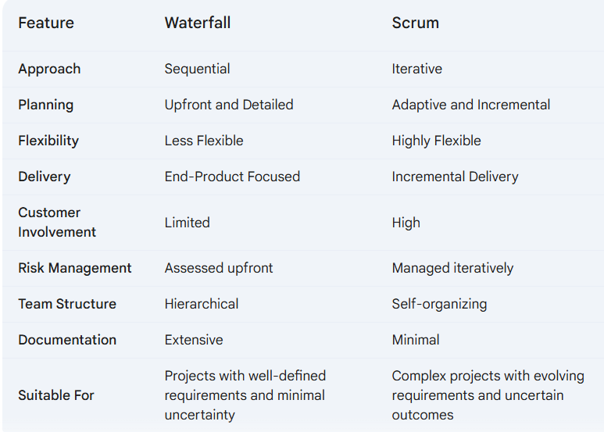
Difference between waterfall & scrum

Slide 5
AI AGENTS (Roles)
Product Owner: Defines the product vision, prioritizes the backlog, and represents the customer's needs.
Scrum Master: Facilitates Scrum ceremonies, removes impediments, and coaches the team.
Business Analyst: Elicits requirements, translates business needs into technical requirements, and creates user stories.
UI/UX Designer: Designs the user interface and user experience, creating wireframes, mockups, and prototypes.
Developer: Develops and tests the software, working closely with the UI/UX Designer and the Business Analyst.
QA Engineer: Tests the software to ensure quality, identifies and reports defects, and works with the development team to fix issues.
Technical Writer (Documentation Engineer): Creates and maintains technical documentation, such as user manuals and API documentation.

Slide 6
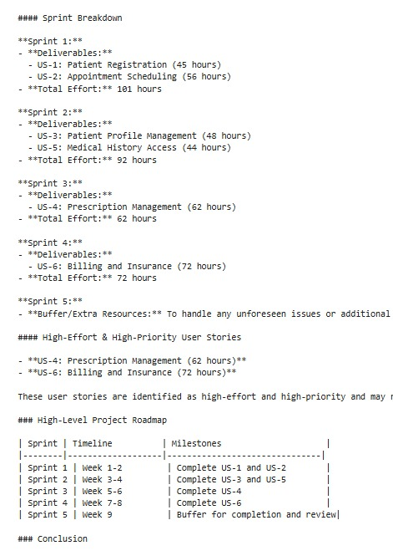
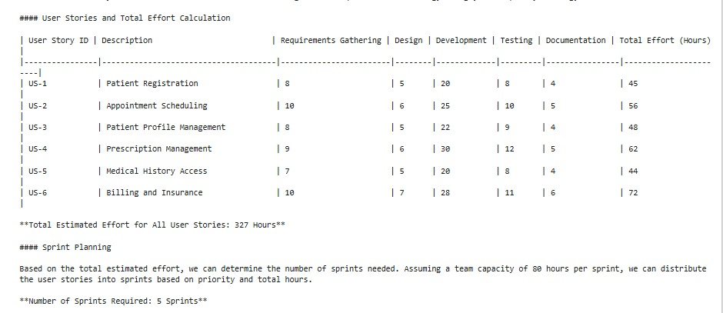
Experiment-1 (Langchain)

Slide 7
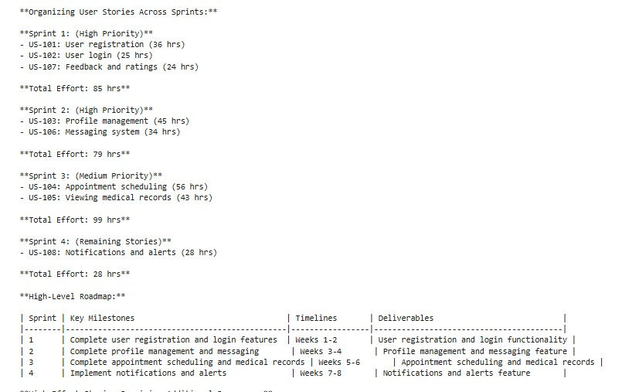
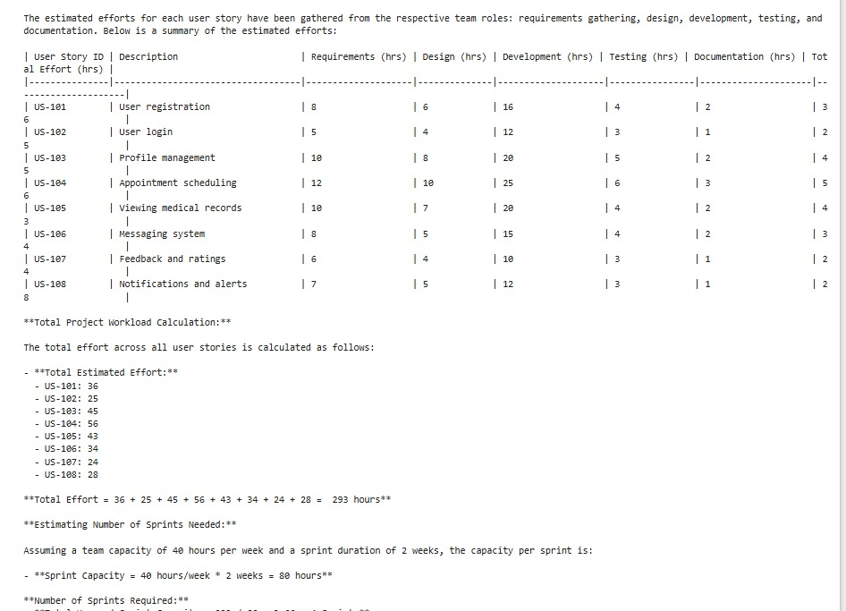
Experiment-2 (LANGCHAIN)

Slide 8
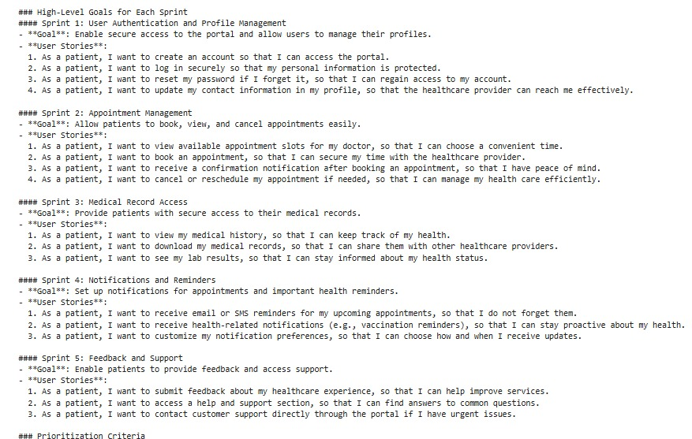
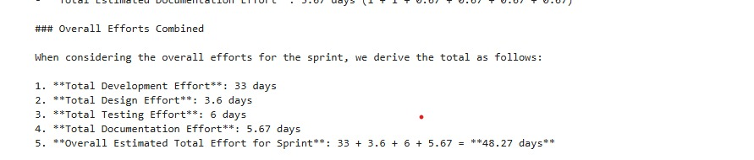
EXPERIMENT-3 (AUTOGEN)

Slide 9
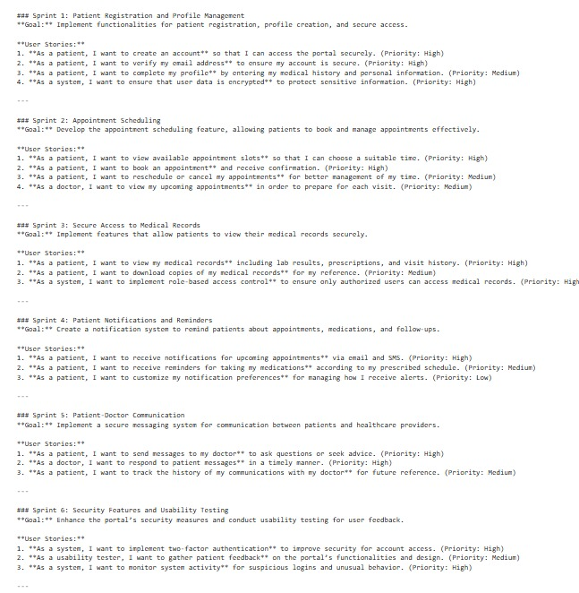
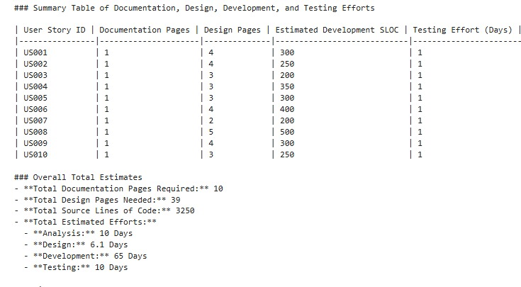
Experiment-4 (Autogen)

Slide 10
Comparison
Experiment using | Langchain | Langchain | Autogen | Autogen
Total Sprints | 5 | 4 | 5 | 6
Total User Stories | 6 | 8 | 6 | 10
Duration | 327 hours (Approx 41 days) | 293 hours (Approx 37 days) | 387 hours (Approx 48 days) | 728 hours (Approx 91 days)

Slide 11
conclusion
In developing the Patient Care Web Portal, we used both LangChain and AutoGen frameworks to simulate an Agile team of AI agents with distinct roles (Product Owner, Scrum Master, Developer, etc.). While AutoGen provided an effective initial team structure, LangChain ultimately proved more flexible and robust for enabling task-specific interactions and adaptive collaboration within the Agile framework. LangChain’s advanced chaining capabilities facilitated dynamic task handoffs and improved inter-agent communication, enhancing sprint planning, daily stand-ups, reviews, and retrospectives. This flexibility allowed for more cohesive, efficient teamwork, reducing manual intervention and supporting a high-quality, patient-centric software product. Overall, LangChain's adaptability and integration capabilities made it the superior choice for managing a virtual AI team in complex, iterative development.

